Slide 1
CS2040 Lab#02 B03

Slide 2
Tips for dealing with a bug
Everyone has the experience of being stuck in a bug for a long time.
It is a ubiquitous phenomenon, so no need to be anxious or doubt ourselves.
Understand the meaning of error/exception message (by google)
After you get familiar with common exceptions, you will solve them more quickly. (for instance, NullPointerException thrown when an application attempts to use an object reference that has the null value)
Print out notes to keep track of the flow of your code. (for example, in dating, print out the information about a participant when put him/her in the queue)
Take a rest or switch your attention to other tasks.

Slide 3
Lab 1

Slide 4
CS2040 Lab #01
Qn1. Mexseq

Slide 5
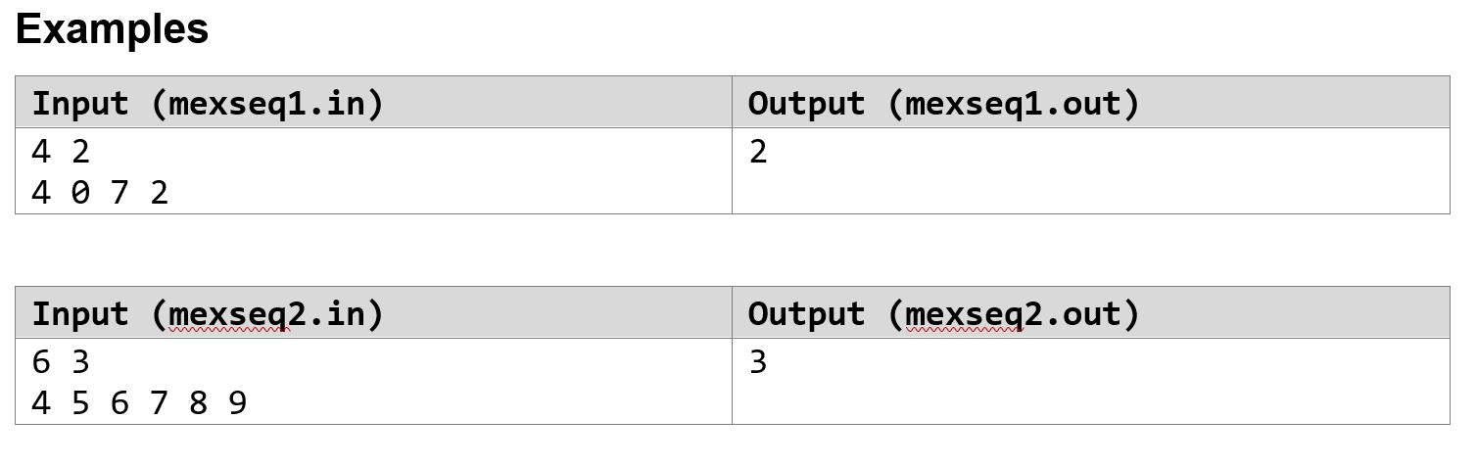
Qn1. Uncle Grandpa and MEX
MEX: The MEX of a sequence is the minimum non-negative integer that doesn’t appear in the sequence.
For example, the MEX of the sequence [0 5 2 1] is 3 , and the MEX of the sequence [1 1 2 3 4] is 0.
“Good”: the MEX of this sequence is exactly x.
Make a sequence “good” in the minimum number of operations (addition/removal)
Notes:
Very simplified

Slide 6
Idea - Properties
Numbers > x don’t affect MEX
Repeats don’t affect MEX
Need all numbers < x present to have MEX = x
Therefore:
Only need to remove a number if it is exactly x
Only need to add a number if it is < x and not already present
Notes:
Simple qn with simple algo

Slide 7
Idea - Variables
A counter to store the answer.
Think about which integers should be removed/added.
An array int[x+1]
Store the count of each integer <= x.
The absence/presence of such integers would affect the answer.
Notes:
Simple qn with simple algo

Slide 8
Idea - Algorithm
Read n and x, set counter = 0
For each integer i in the sequence:
If i <= x, increment array[i] by 1.
Finally, loop through array :
For each array[i]==0 add 1 to counter
Add array[x] to counter
Notes:
Simple qn with simple algo

Slide 9
CS2040 Lab #01
Qn2. New Dating App

Slide 10
Qn2. New Dating App
Users of this app are in one of two genders: male or female
At any point in time, users can submit a date request to find a person of the opposite gender to date
App matches users in first come first serve manner
If no match can be made, person waits
If can match, will match earliest request and print the match
At the end, print average waiting time
Input (dating1.in) | Output (dating1.out)
5 MALE Bob MALE Daris FEMALE Alice MALE Bob FEMALE Daris | Bob matches Alice Daris matches Daris 1.25
Notes:
Very simplified

Slide 11

Queues - First In First Out
You always join from the Tail/Back end
You get processed from the Head/Front of the Queue.
Notes:
First thing that popped into my mind when i read question

Slide 12
Qn2. New Dating App
Some of you didn’t create a class to store information about the participants. That’s a lack of modularity.
Why should we achieve modularity? To increase the maintainability, readability of the code and to make the program handy to make any changes in future or to correct the errors.
It will be messy and hard to manage if you use several ArrayLists to store information about participants in main function. What if we also need to record the age, address, contact number, nationality, etc.?
Notes:
Very simplified

Slide 13
Planning
Let’s have 2 Queues, a Male Queue and a Female Queue.
Head
Tail
Male Queue:
Head
Tail
Female Queue:
Notes:
Always plan before jumping straight to coding

Slide 14
Possible Data Structure
// example
Queue<Person> maleQueue = new LinkedList<>();
Queue<Person> femaleQueue = new LinkedList<>();
Queue<E>
Type | Method | Tldr Description
boolean | add(E e) | Inserts element to the back of the Queue.
E | poll() | Retrieves and removes the head of this queue.
boolean | isEmpty() | Returns true if this collection contains no elements.
Notes:
Java Api 11 is your best friend I dun care if you LL list = new LL<>();

Slide 15
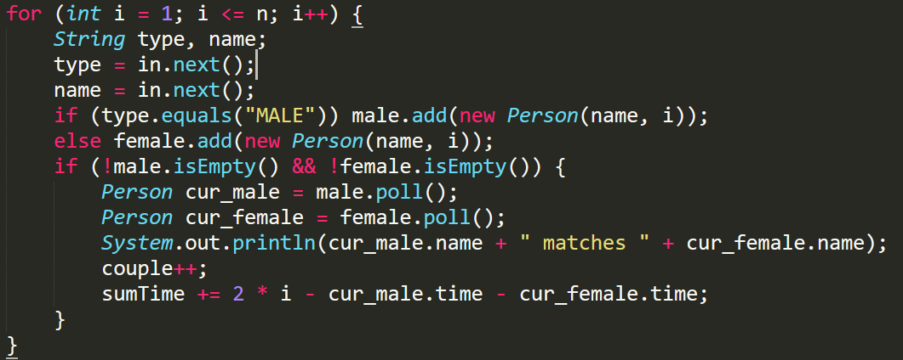
Possible Data Structure
It’s better to process the input while reading in instead of processing after reading in all the inputs.
Because we can poll a person out of queue if he/she is processed, thus requiring less space.

Slide 16
Possible Data Structure
Another very common data structure we often use in Java is the ArrayList. We could use the ArrayList implementation of the Queue interface instead of LinkedList. However, it is not so good as LinkedList in this question. Why?

Slide 17
Possible Data Structure
Another very common data structure we often use in Java is the ArrayList. We could use the ArrayList implementation of the Queue interface instead of LinkedList. However, it is not so good as LinkedList in this question.
It takes O(n) time to poll the first elements, because this operation will shift all other elements to left.
We can maintain an integer to keep track of the head of the queue, which takes O(1) time to update the queue (lazy deletion). However, this methods use more space than LinkedList.

Slide 18
Representation
Lets create a simple a Person classes.
// example
class Person {
String name;
int time;
}
Use of time will be more apparent in the following slides.

Slide 19
Example Sequence
Bob(M) enters tail of maleQueue with time 0
No matches yet.
Time: 0
Bob
0
Male Queue:
Female Queue:

Slide 20
Example Sequence
Daris(M) enters tail of maleQueue with time 1
No matches yet.
Time: 1
Bob
0
Daris
1
Male Queue:
Female Queue:

Slide 21
Example Sequence
Alice(F) enters tail of femaleQueue with time 2
Time: 2
Bob
0
Daris
1
Male Queue:
Alice
2
Female Queue:

Slide 22
Example Sequence
We have a match!
Time: 2
Bob
0
Daris
1
Male Queue:
Alice
2
Female Queue:

Slide 23
Example Sequence
Match 1
Bob
0
Bob waited 2 - 0 = 2 turns.
Time: 2
Alice
2
Alice waited 0 turns.
Daris
1
Male Queue:
Female Queue:

Slide 24
Example Sequence
Match 1
Bob
0
Bob waited 2 - 0 = 2 turns.
Time: 3
Alice
2
Alice waited 0 turns.
Daris
1
Bob
3
Male Queue:
Female Queue:

Slide 25
Example Sequence
Match 1
Bob
0
Bob waited 2 - 0 = 2 turns.
Time: 4
Alice
2
Alice waited 0 turns.
Daris
1
Bob
3
Male Queue:
Daris
4
Female Queue:

Slide 26
Example Sequence
Match 1
Bob
0
Bob waited 2 - 0 = 2 turns.
Time: 4
Alice
2
Alice waited 0 turns.
Daris
1
Bob
3
Male Queue:
Daris
4
Female Queue:

Slide 27
Example Sequence
Match 1
Bob
0
Bob waited 2 - 0 = 2 turns.
Time: 4
Alice
2
Alice waited 0 turns.
Bob
3
Male Queue:
Match 2
Daris
1
Daris waited 4 - 1 = 3 turns.
Female Queue:
Daris
4
Daris waited 0 turns.

Slide 28
Example Sequence
Match 1
Bob
0
Bob waited 2 - 0 = 2 turns.
Time: End
Alice
2
Alice waited 0 turns.
Turns waited, 2 + 3 = 5 turns.
People Matched = 4
Average Waiting Time 5 / 4 = 1.25 turns
Match 2
Daris
1
Daris waited 4 - 1 = 3 turns.
Daris
4
Daris waited 0 turns.
Notes:
What if 0 matches? Qn addresses it

Slide 29
Lab 02

Slide 30
CS2040 Lab #02
Qn1. Football

Slide 31
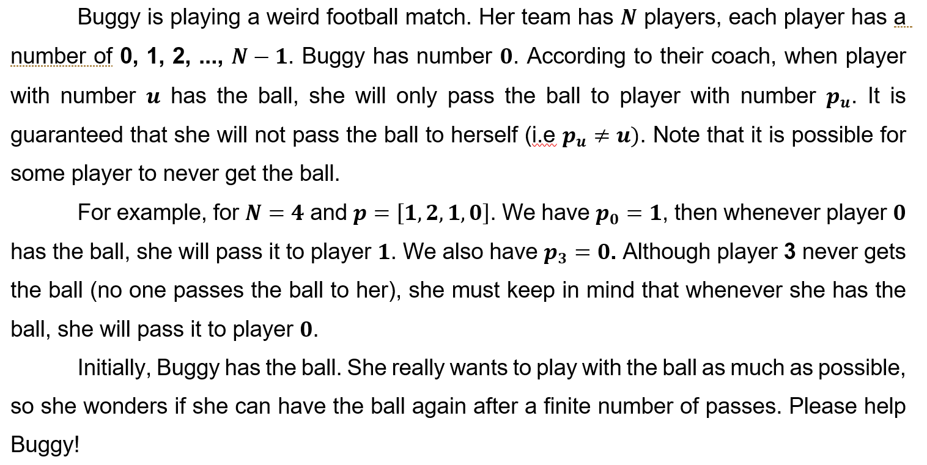
Q1 Football

Slide 32
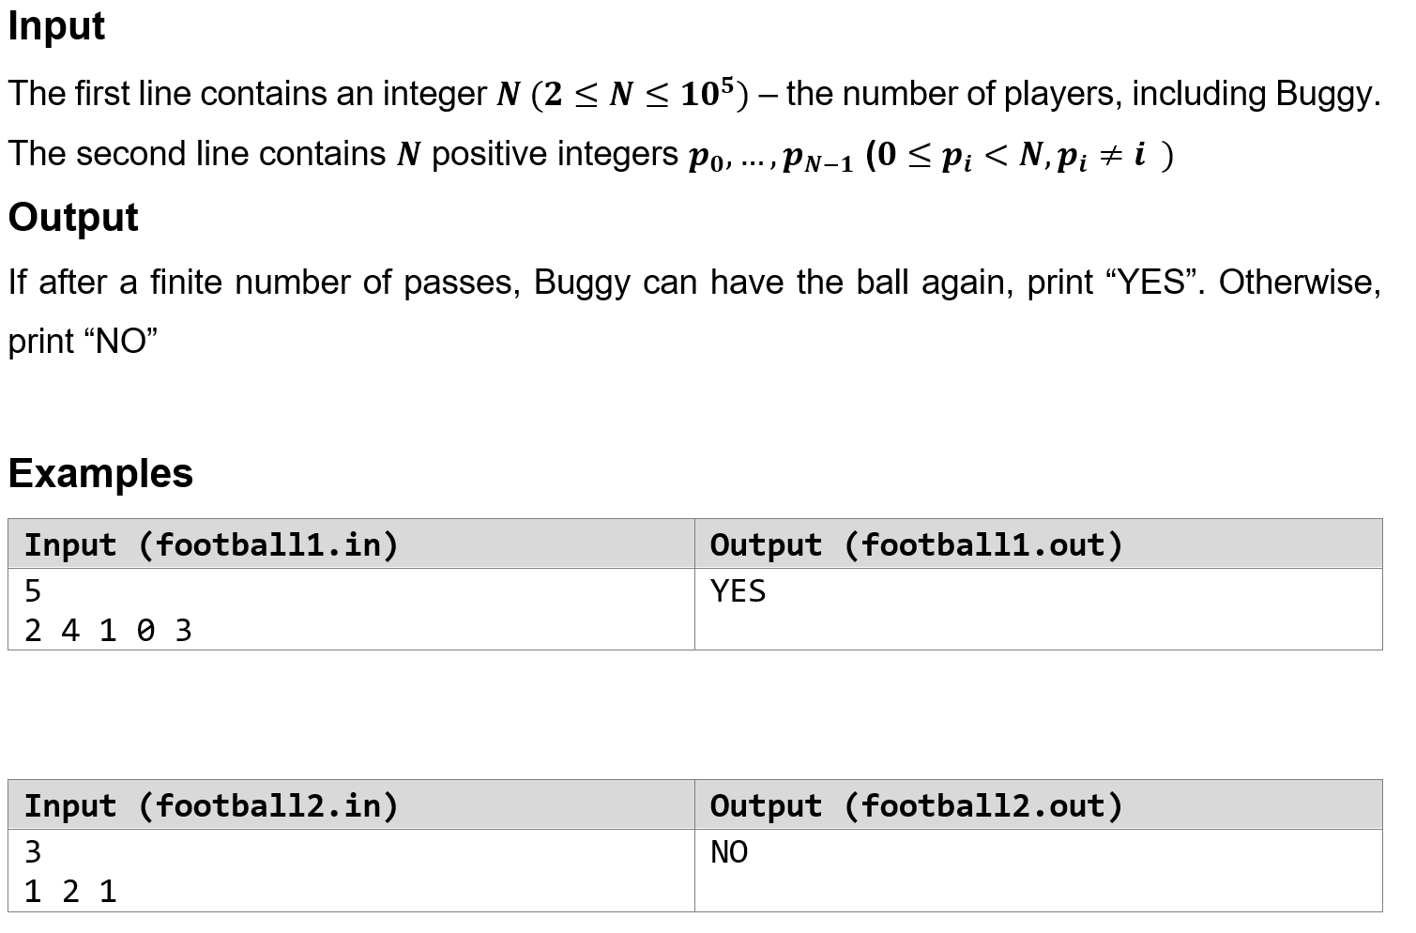
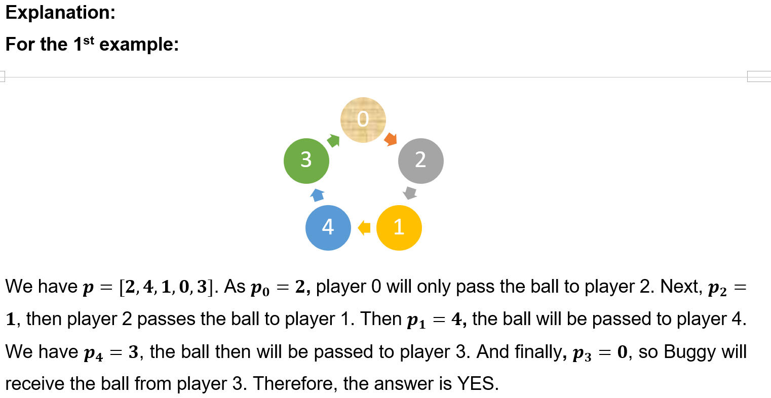
Q1 Football

Slide 33
Things to note:
Buggy (player 0) starts with the Ball
Player cannot pass the ball to himself
Data Structures to Consider:
Array
ArrayList
HashMap

Slide 34
Planning
How do we know when Buggy gets the ball?
Make sure you loop through the number of times that is stated.

Slide 35
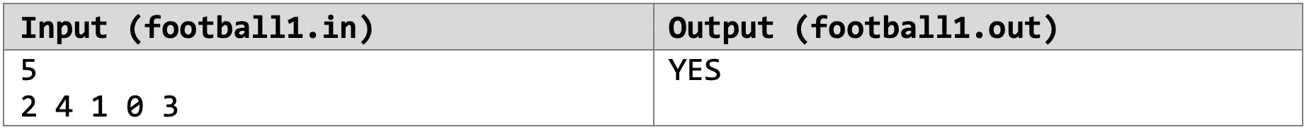
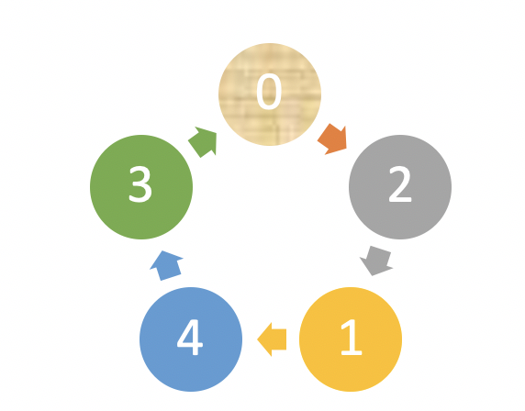
Example - YES
Buggy would be able to get the ball.
Number of passes: 5
We loop through the passes and it Buggy did receive the ball.
*Note: You cannot just look at the numbers and if 0 appears you say Buggy would receive it. Why?

Slide 36
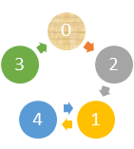
Example - NO
Input | Output
5 2 4 1 0 1 | NO
You cannot just look at the numbers and if 0 appears you say Buggy would receive it. Why?
It is possible for a player to be assigned to pass to Buggy (p0), but that player may never get the ball at all.

Slide 37
CS2040 Lab #02
Qn2. Editor

Slide 38


Problem
Make a text editor for Uncle Grandpa. The text editor uses a cursor to navigate. It also has a string buffer to support copy-paste operations. Return the string after processing all operations.
Constraints:
Input string, S
Number of operations, n

Slide 39
Valid Operations
Operation | Function
R | Increase the position of the cursor by 1. If the cursor is already at the last position, nothing changes.
L | Decrease the position of the cursor by 1. If the cursor is already at the first position, nothing changes.
C k | Copy substring of min(k, cursor to end of string) length to buffer, starting from character immediate right of cursor.
P | Insert buffer content to position immediate left of cursor. Empty buffer.
I c | Insert 1 character to position immediate left of cursor.
B | Delete 1 character to position immediate left of cursor. If the cursor is at position 0, nothing changes.

Slide 40
Planning
Consider the following points:
Input handling
Storage of letters - data type, data structure
Modularity - one method for one operation?
Reusability - paste() is k * insert()
How to copy efficiently?

Slide 41
Possible Data Structures
Note: Use of array, Stack, Queue, ArrayList not allowed.
LinkedList API and its methods - TLE
StringBuilder - banned
LinkedList API and ListIterator
Self-implemented Doubly Linked List with cursor

Slide 42
ListIterator
Returns | Method | Description
boolean | hasNext() | Calling next() returns an element.
E | next() | Returns next element in the list and advances the cursor position
boolean | hasPrevious() | Calling previous() returns an element.
E | previous() | Returns previous element in the list and moves the cursor position backwards
void | add(E e) | Element is inserted immediately before the element that would be returned by next()
void | remove() | Removes from the list the last element that was returned by next() or previous()
For illustration of ListIterator: https://www.journaldev.com/13457/java-listiterator

Slide 43
Time Complexity
Method | Linked List API ** | List Iterator API
hasNext() | No cursor | O(1)
next() | No cursor | O(1)
hasPrevious() | No cursor | O(1)
previous() | No cursor | O(1)
add(E e) to index k | O(n) | O(1) already at k
remove() from index k | O(n) | O(1) already at k
** From the API: All of the operations perform as could be expected for a doubly-linked list.

Slide 44
ListIterator
Avoid concurrentModificationException error.
Essentially, the ConcurrentModificationException is used to fail-fast when something we are iterating on is modified.
Method 1:
Call LL’s add method to add names
LinkedList<String> nameList = new LinkedList<String>();
nameList.add("Shyam");
nameList.add("Rajat");
nameList.add("Paul");
// Initialise list iterator
ListIterator<String> cursor = names.listIterator();
LinkedList<String> nameList = new LinkedList<String>();
// Initialise list iterator
ListIterator<String> cursor = names.listIterator();
cursor.add("Shyam");
cursor.add("Rajat");
cursor.add("Paul");
Method 2:
Call iterator’s add method to add names

Slide 45
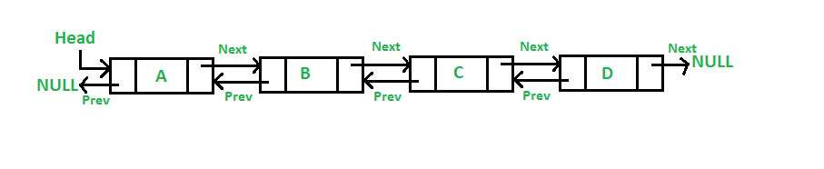
Doubly Linked List Node Implementation
public static class Node {
public Node prev;
public Node next;
public char c;
public Node(char c) {
prev = next = null;
this.c = c; id = sum; sum++;
}
}
You can use generics to allow your nodes to hold elements of the type you want.
For more information: https://www.geeksforgeeks.org/angle-bracket-in-java-with-examples/

Slide 46
Doubly Linked List Insert
Scenario: Insert to the middle
cursor
Bobby
David
Fred
cursor.next.prev = newNode;
newNode.next = cursor.next;
Charlie
newNode.prev = cursor;
newNode
cursor.next = newNode;

Slide 47
Doubly Linked List Delete
Scenario: Delete Charlie
cursor
Bobby
David
Fred
cursor.prev.next = cursor.next;
Charlie
cursor.next.prev = cursor.prev;
cursor
cursor = cursor.prev;

Slide 48
CS2040 Lab #02
Qn3. Singapore Valley

Slide 49
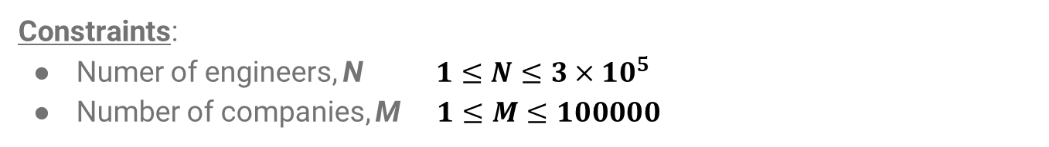
Problem
Develop a program to manage all transactions. The transactions track the engineers in each company when a company buys/takes over another company. Return number of operating companies, company numbers and their engineers (sorted by ids)

Slide 50

Example
Company | Engineers
0 | 0, 1, 2
1 | 3
2 | 4
3 | 5
Company | Engineers
0 | 0, 1, 2
1 | 3
2 | 4, 5
3 | No longer exists
Input: 2 3

Slide 51
Planning
Consider the following points:
Storage/Representing of companies - data structure
Fixed number of companies
Company numbers represented from 0 to M-1
Storage of engineers
List of engineers for each company?
Constantly joining list of engineers 🡪 Is there an efficient way?

Slide 52
Data Structures for Engineers
Array
Number of engineers for each company not fixed
ArrayList
Only can add individual elements of 2nd ArrayList to 1st ArrayList
LinkedList API
Joining 2 LinkedList would require traversing 1st LinkedList to its tail
Self-implemented LinkedList with tail attribute

Slide 53
Representing Companies
Fixed number of companies
Companies represented by number from 0 to M-1
Use an Array
More specifically, Array of List of Engineers!

Slide 54
Representing Companies
When a company A buys company B, company B no longer exists
How to track which companies exist and no longer exist?
boolean isBought[]
Loop through array to determine which companies are bought

Slide 55

Linked List Implementation
public static class MyList {
public Node head;
public Node tail;
public MyList() {
head = null;
tail = null;
}
Tail
Head
NULL

Slide 56
Linked List Append
Scenario: Appending Node
1
2
3
tail
5
newNode
tail.next = newNode;
tail = newNode;

Slide 57
Doubly Linked List Append
Scenario: Append another Linked List
newList.head
newList.tail
1
2
3
5
6
tail
tail.next = newList.head;
tail = newList.tail;

Slide 58
Demonstration

Slide 59
Mock Visualgo quiz

Slide 60
Mock Visualgo quiz
We will do 10 questions in 10 minutes then have 5 minutes to complete the submission process. You need to show the screen and click the submit button, then I will take down the score. If you are not satisfied with your scores and are still within the 10 minutes, you can start another quiz. But you must submit it within the 10 minutes period.
For the rest of the Visualgo quizzes. You need another camera to show your environment that there is no one with you when you are doing the quiz.
https://visualgo.net/training?diff=Hard&n=10&tl=15&module=list

Slide 61
Thank you!

